Slide 1
2014 CYAC Summer
Arduino Course
Lecture 01
Introduction to Arduino
吳振豪

Slide 2
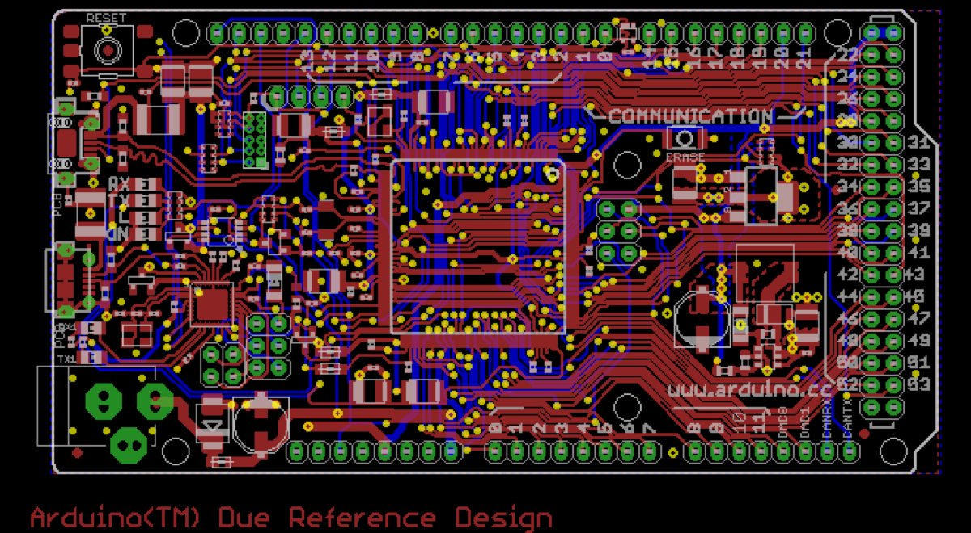

Slide 3

What’s the Arduino?
Arduino is a single-board microcontroller
It comes with a simple integrated development environment (IDE)
Open Source hardware and software arduino.cc
Easy to learn, use and get

Slide 4
Software vs Firmware vs Hardware
Software
Yeah, the programs
Firmware
Program burn into ROM, executed when startup
Hardware (aka bare machine)
A system without it’s software clothing

Slide 5
The world of Open Source
Open hardware
Open software

Slide 6
License
Why there is always has a license?

Slide 7
What’s the IDE
Integrated development environment
The platform let developer easier to work
Example :
Dev-C++
Keil C
Eclipse
Code::Blocks

Slide 8
Basic Arduino hardware
Atmel AVR Atmega328
USB type B interface
Digit pins
Analog pins
Reset button

Slide 9
Microcontroller
A microcontroller (MCU) is a small computer on a single integrated circuit (IC) containing a processor core, memory, and programmable input/output (I/O) peripherals.
Similar to System on Chip (SoC) but quit simple electronics.stackexchange.com/questions/16828/microcontroller- vs-system-on-chip
Sometimes, it’s the best choice

Slide 10
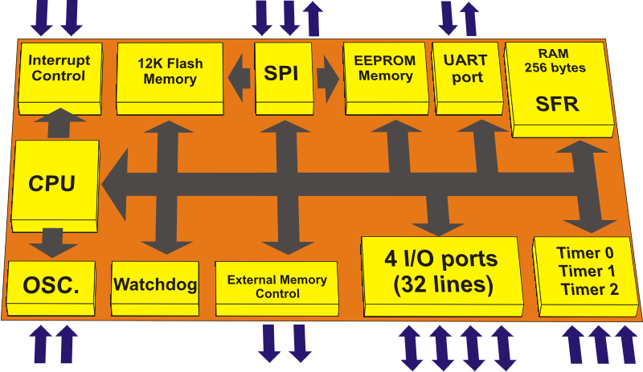

Slide 11
Get started with Arduino
Install Arduino via internet arduino.cc

Slide 12
Driver issue

Slide 13
Get example code
Use IDE’s example

Slide 14
Take note

Slide 15
Why does it run like that?
setup scope
loop scope

Slide 16
Take note

Slide 17
The resource you can use
Please learn how to use google ?

Slide 18
Take note

Slide 19
Practice
Is Arduino program a software or firmware?
Where to find the resource of Arduino?
Import a basic program for example
If I want to set LED on at beginning where you have to modified?

Slide 20
Install Arduino development environment
Create each folder storage the code you write each time

